Slide 1


Udo Riegler
02.02.2024

Slide 2

Outline
Executive Summary
Introduction
Methodology
Results
Conclusion
Appendix

Slide 3
Executive Summary
Summary of used methodologies:
We collected data from various public source as. After raw data has been collected, the data quality were improved by performing data wrangling.
Then we started exploring the processed data. We found some really interesting real-world datasets together. We performed SQL quiring as we query the data and gather insights.
We got further insights into the data by applying some basic statistical analysis and data visualization. In this way we saw directly how variables are related to each other.
Finally we drill down into finer levels of detail by splitting the data into groups defined by categorical variables or factors in the processed data.
Summary of all results

Slide 4
Introduction
Space X advertises Falcon 9 rocket launches on its website with a cost of 62 million dollars; other providers cost upward of 165 million dollars each, much of the savings is because Space X can reuse the first stage.
Therefore if we can determine if the first stage will land, we can determine the cost of a launch. This information can be used if an alternate company wants to bid against space X for a rocket launch.
In this lab we create a machine learning pipeline to predict if the first stage will land given the data from the preceding labs.
As a potential competitor of Space X, the main task is to determine the price of each launch and if Space X will be able to reuse the first stage and reduce cost of each launch, using this special feature.

Slide 5

Section 1

Slide 6
Methodology
Executive Summary
Data collection methodology:
The used data set was collected from a public website (“SpaceX REST API”, given url())
Perform data wrangling 1: Request and parse the SpaceX launch data using the GET request
2: Filter the data to only include ”Falcon 9” launches
Perform exploratory data analysis (EDA) using visualization and SQL
Perform interactive visual analytics using Folium and Plotly Dash
Perform predictive analysis using classification models
We buildt, tuned and evaluated classification models

Slide 7

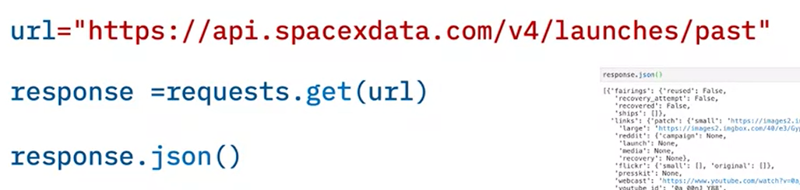
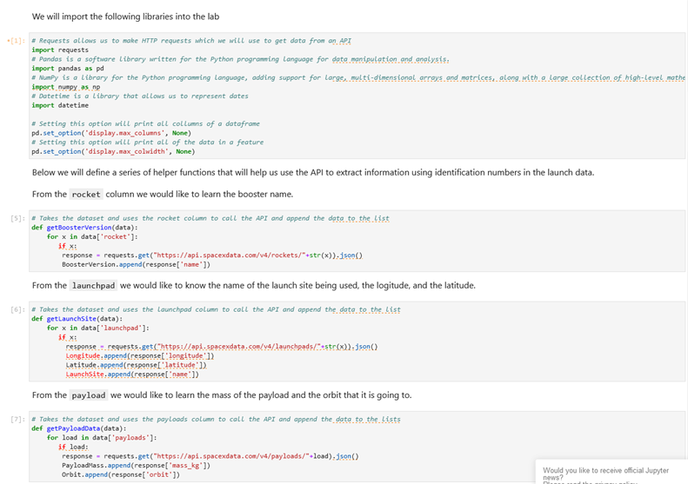
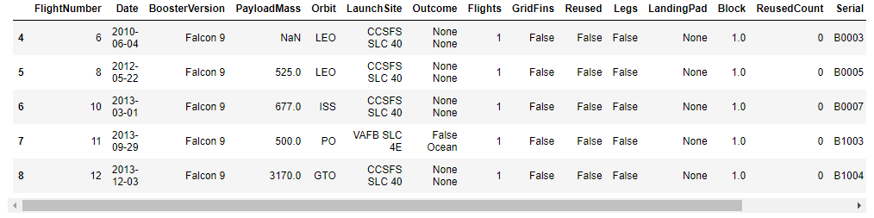
2: Filter the dataframe to only include Falcon 9 launches
Data Collection
Describe how data sets were collected from the posted “SpaceX REST API”, with given url().
Data collection process use key phrases and flowcharts: in “Lab 1: Collecting the data”:
0: Import Libraries and Define Auxiliary Functions 1: Request and parse the SpaceX launch data using the GET request
2: Filter the dataframe to only include ”Falcon 9” launches

Slide 8
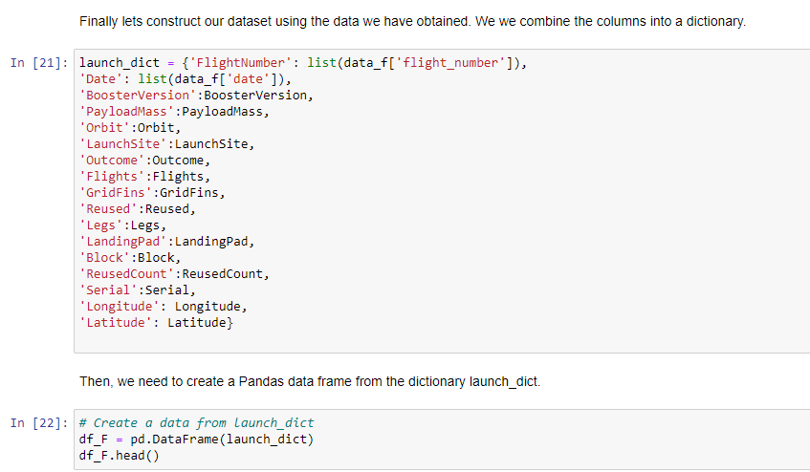
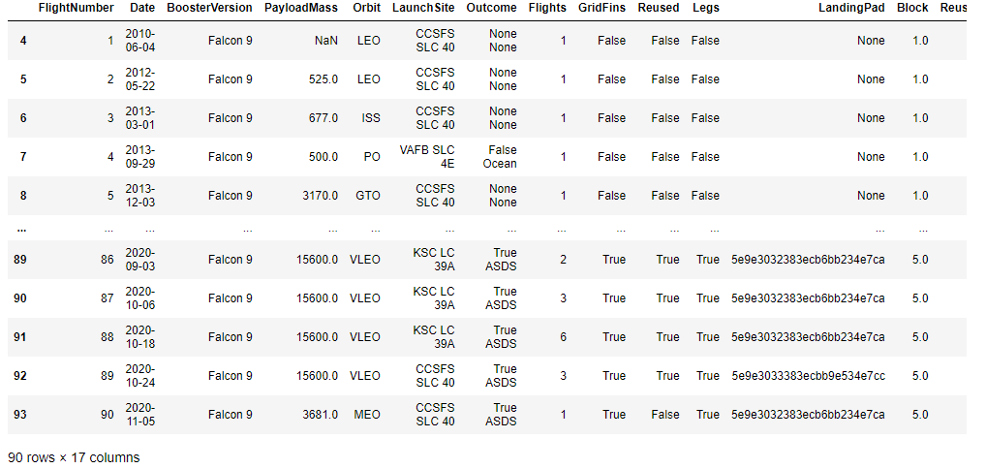
Data Collection – SpaceX API
Data collection with SpaceX REST calls using key phrases and flowcharts:
Import Libraries and Define Auxiliary Functions
→ Request and parse the SpaceX launch data using the GET request
→ Filter the dataframe to only include ”Falcon 9” launches
GitHub URL of the completed SpaceX API calls notebook: https://github.com/UdoRiegler/IBM_10_Capstone/blob/main/jupyter-labs-spacex-data-collection-api_solved.ipynb

Slide 9
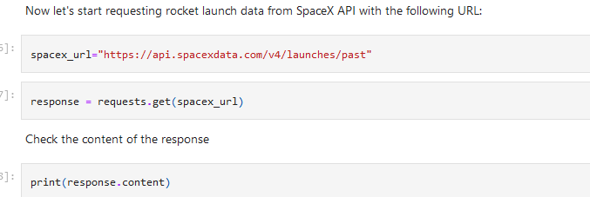
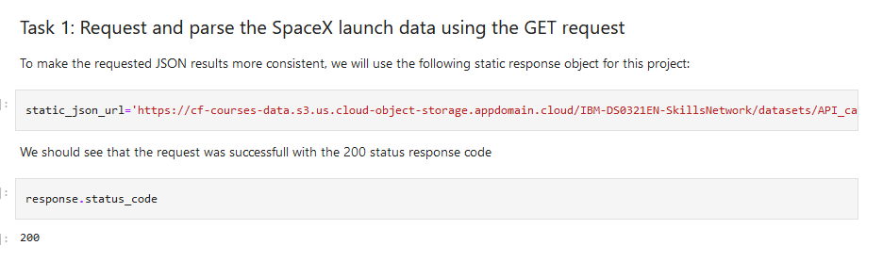
Data Collection - Scraping
Web scraping process
Import Libraries and Define Auxiliary Function
→ Request and parse the SpaceX launch data using the GET request
Filter the dataframe to only include ”Falcon 9” launches
GitHub URL of the completed web scraping notebook, as an external reference and peer-review purpose: https://github.com/UdoRiegler/IBM_10_Capstone/blob/main/labs-jupyter-spacex-Data%20wrangling_solved2.ipynb

Slide 10
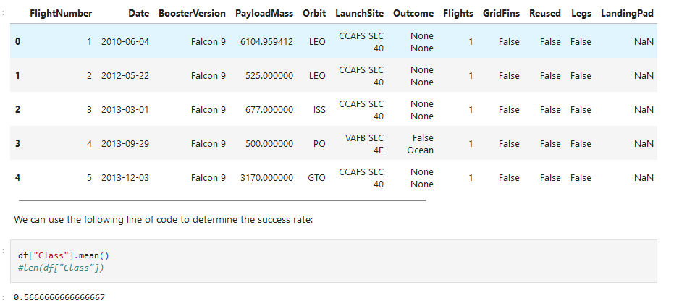
Data Wrangling
Objectives:
Perform exploratory Data Analysis and determine Training Labels
Exploratory Data Analysis
Determine Training Labels
Data wrangling process:
1: Calculate the number of launches on each site
2: Calculate the number and occurrence of each orbit
3: Calculate the number and occurence of mission outcome of the orbits
4: Create a landing outcome label from Outcome column
Add the GitHub URL of your completed data wrangling related notebooks, as an external reference and peer-review purpose: https://github.com/UdoRiegler/IBM_10_Capstone/blob/main/Python_01_Collecting_Wrangling_Data.ipynb

Slide 11
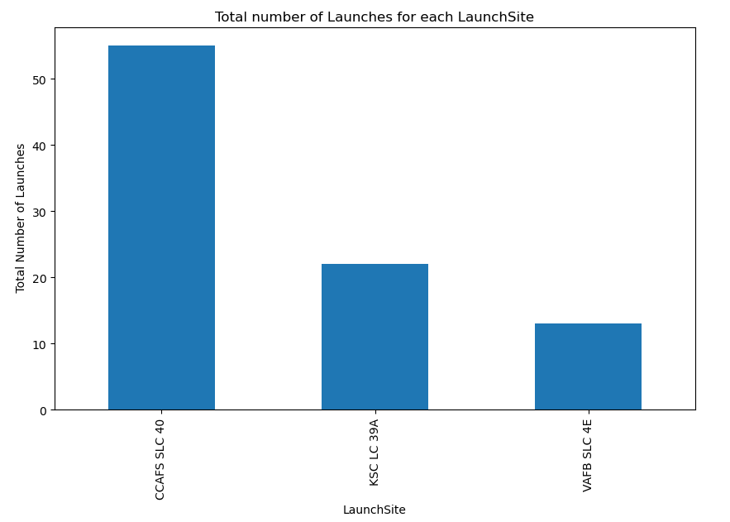
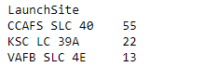
EDA with Data Visualization
The plotted charts show the total success launches by site.
GitHub URL of completed EDA with data visualization notebook for peer-review purpose: https://github.com/UdoRiegler/IBM_10_Capstone/blob/main/labs-jupyter-spacex-Data%20wrangling_solved3.ipynb

Slide 12
EDA with SQL
Summarizing the performed SQL queries: ● The names of the unique launch sites ● The first 5 records where launch sites begin with `CCA` ● The total payload mass carried by booster version F9 v1.1 ● The average payload mass carried by booster version F9 v1.1 ● The date of the first successful landing on a ground pad ● The names of boosters which have successfully landed on drone ship and had payload mass greater than 4000 but less than 6000 ● Calculate the total number of successful and failure mission outcomes ● List the names of the booster which have carried the maximum payload mass ● List the failed landing outcomes in drone ship, their booster versions, and launch site names for in year 2015
GitHub URL of completed EDA with data visualization notebook for peer-review purpose: https://github.com/UdoRiegler/IBM_10_Capstone/blob/main/jupyter-labs-eda-sql-coursera_sqllite_solve.ipynb

Slide 13
Build an Interactive Map with Folium
Summarize what map objects such as markers, circles, lines, etc. you created and added to a folium map
Explain why you added those objects
GitHub URL of completed EDA with data visualization notebook for peer-review purpose: https://github.com/UdoRiegler/IBM_10_Capstone/blob/main/

Slide 14
Build a Dashboard with Plotly Dash
Summarize what plots/graphs and interactions you have added to a dashboard
Explain why you added those plots and interactions
GitHub URL of your completed Plotly Dash lab, as an external reference and peer-review purpose: https://github.com/UdoRiegler/IBM_10_Capstone/blob/main/jupyter-labs-eda-sql-coursera_sqllite_solve.ipynb

Slide 15
Predictive Analysis (Classification)
Summarize how you built, evaluated, improved, and found the best performing classification model
You need present your model development process using key phrases and flowchart
GitHub URL of your completed predictive analysis lab, as an external reference and peer-review purpose: https://github.com/UdoRiegler/IBM_10_Capstone/blob/main/SpaceX_Machine_Learning_Prediction_Part_5.jupyterlite_solved.ipynb

Slide 16
Results
Exploratory data analysis results
Interactive analytics demo in screenshots
Predictive analysis results

Slide 17

Section 2

Slide 18
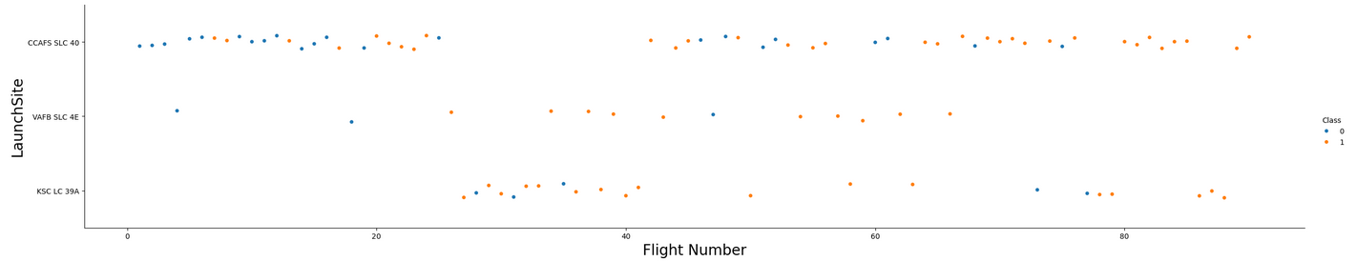
Flight Number vs. Launch Site
Scatter plot of Flight Number vs. Launch Site
The scatter plot shows the flight numbers of all launches, classified as “Success” (orange dots) or “failure” (blue dots), subdivided by the different launch sites (“CCAFS SLC 40”, “VAFB SLC-4E” and “KSC LC 39A”). Result: We see that different launch sites have different success rates. “CCAFS LC-40”, has a success rate of 60 %, while “KSC LC-39A” and “VAFB SLC 4E” has a success rate of 77%.

Slide 19
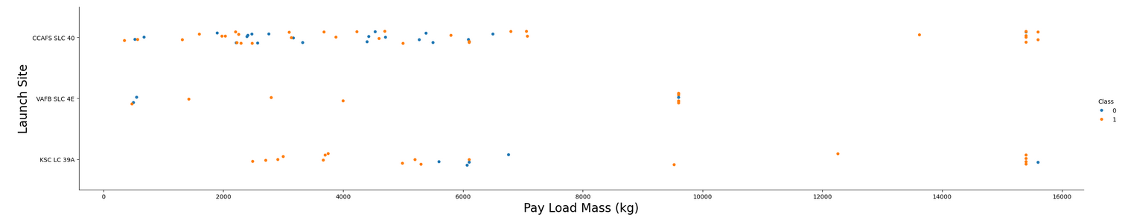
Payload vs. Launch Site
Show a scatter plot of Payload vs. Launch Site
Result: We see that different launch sites have different payload masses. This affects the success rate. “CCAFS LC-40”, has a success rate of 60 %, while “KSC LC-39A” and “VAFB SLC 4E” has a success rate of 77%. The highest payload mass of 16500 kg shows the highest success rate.

Slide 20
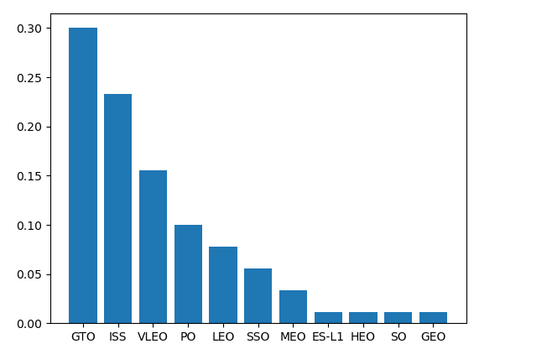
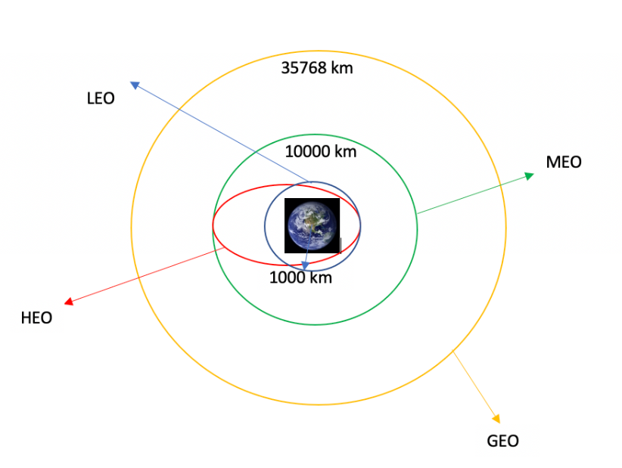
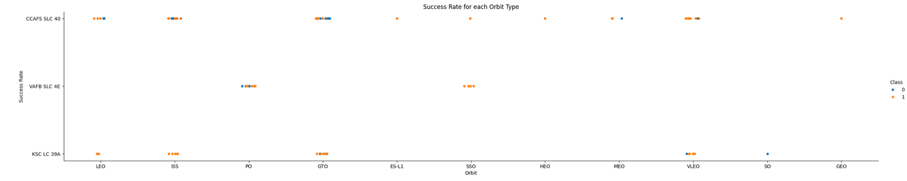
Success Rate vs. Orbit Type
Bar chart for the success rate of each orbit type: - the orbit type “GTO” shows the highest success rate of ~30% followed by “ISS” with ~22%.
The scatter plot shows the flight numbers of all launches, classified as “Success” (orange dots) or “failure” (blue dots), subdivided by the different Orbit types (e.g. “LEO”, “MEO”, “ISS” or “GTO”).

Slide 21

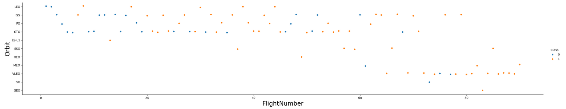
Flight Number vs. Orbit Type
Show a scatter point of Flight number vs. Orbit type
The scatter plot shows the flight numbers of all launches, classified as “Success” (orange dots) or “failure” (blue dots), subdivided by the different Orbit types (e.g. “LEO”, “MEO”, “ISS” or “GTO”). Result: For LEO orbit the Success appears related to the number of flights; on the other hand, there seems to be no relationship between flight number when in GTO orbit.

Slide 22
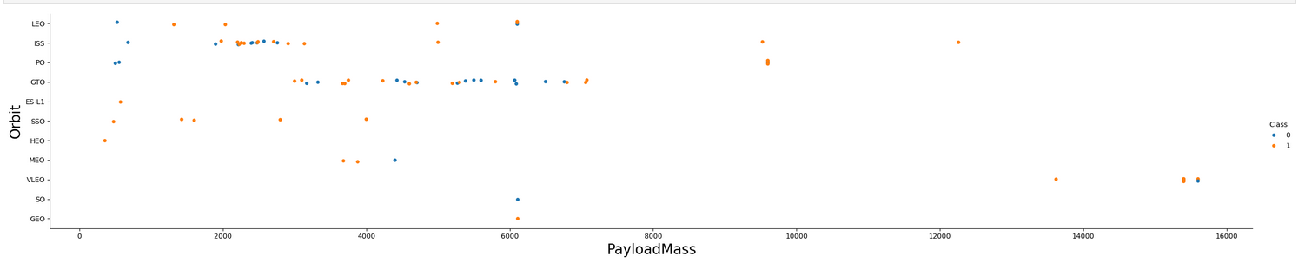
Payload vs. Orbit Type
Show a scatter point of payload vs. orbit type:
The scatter plot shows the pay load mass [kg] of all launches, classified as “Success” (orange dots) or “failure” (blue dots), subdivided by the different Orbit types (e.g. “LEO”, “MEO”, “ISS” or “GTO”). Result: The higher payload masses between 9000 kg and 16500 kg show the highest success rate. With heavy payloads the successful landing or positive landing rate are more for Polar, LEO and ISS. However for GTO we cannot distinguish this well as both positive landing rate and negative landing (unsuccessful mission) are both there here.

Slide 23
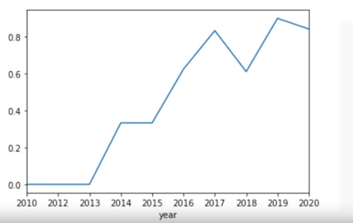
Launch Success Yearly Trend
The line chart of yearly average success rate is continusly increasing from 0% between 2010 and 2013 to ~80% since 2019
Show the screenshot of the scatter plot with explanations

Slide 24
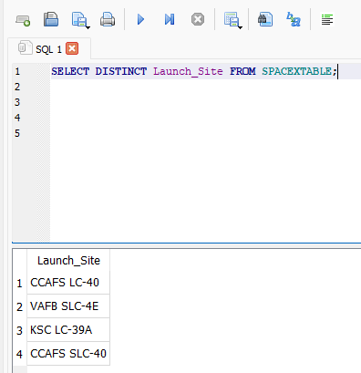
All Launch Site Names
The names of the unique launch sites are:
Cape Canaveral Space Launch Complex 40: “CCAFS LC-40”
Vandenberg Air Force Base Space Launch Complex 4E : “VAFB SLC-4E”
Kennedy Space Center Launch Complex 39A KSC LC 39A : “KSC LC-39A”
Cape Canaveral Space Launch Complex SLC-40: “CCAFS SLC-40”
The location of each Launch Is placed in the column ‘Launch_Site’.

Slide 25
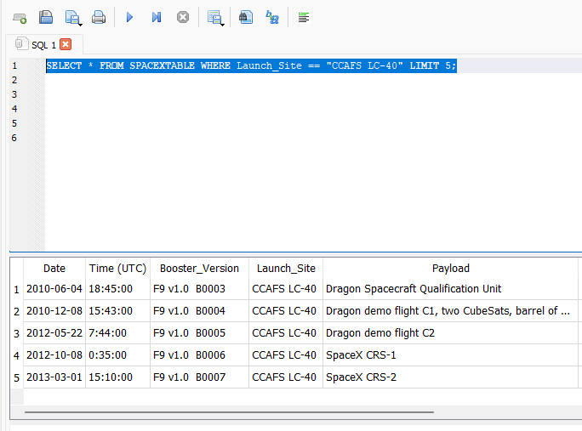
Launch Site Names Begin with 'CCA'
The first 5 records where launch sites begin with `CCA` are dated: 1. 2010/06/04 2. 2010/12/08 3. 2012/05/22 4. 2012/10/08 5. 2013/03/01
Query result with a short explanation here

Slide 26
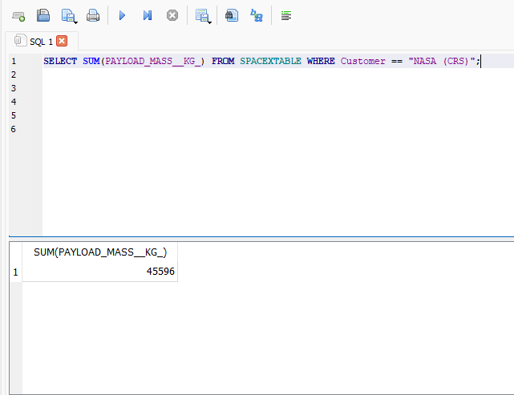
Total Payload Mass
Calculate the total payload carried by boosters from NASA
The total payload mass carried by booster version F9 v1.1 is 45,596 kg.

Slide 27
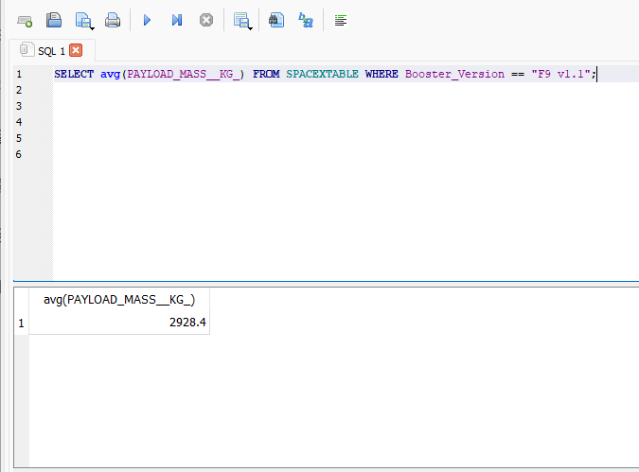
Average Payload Mass by F9 v1.1
Calculate the average payload mass carried by booster version F9 v1.1
The average payload mass carried by booster version F9 v1.1 is 2928.4 kg.

Slide 28
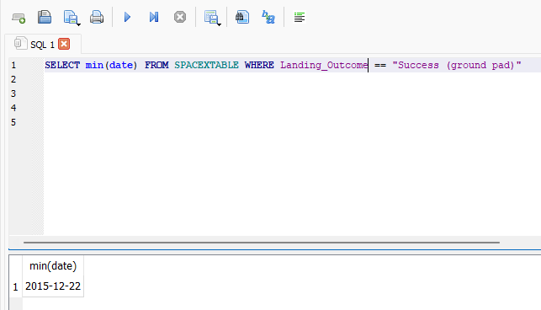
First Successful Ground Landing Date
Find the dates of the first successful landing outcome on ground pad:
The date of the first successful landing on a ground pad is 12/22/2015.

Slide 29
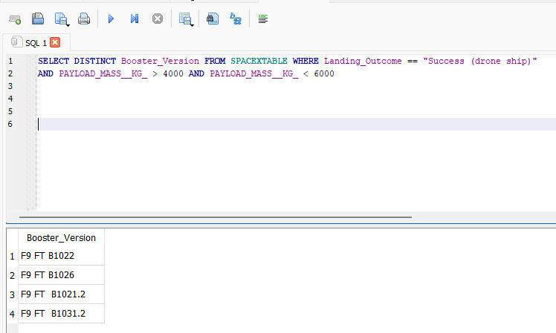
Successful Drone Ship Landing with Payload between 4000 and 6000
List the names of boosters which have successfully landed on drone ship and had payload mass greater than 4000 but less than 6000
Result: 4 booster version listed in the table were able to successfully landed on drone ship and had payload mass greater than 4000 but less than 6000.

Slide 30
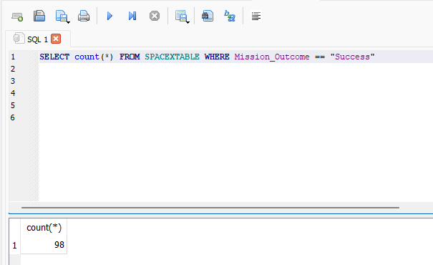
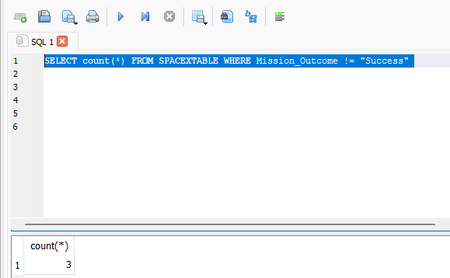
Total Number of Successful and Failure Mission Outcomes
Calculate the total number of successful and failure mission outcomes
Present your query result with a short explanation here

Slide 31
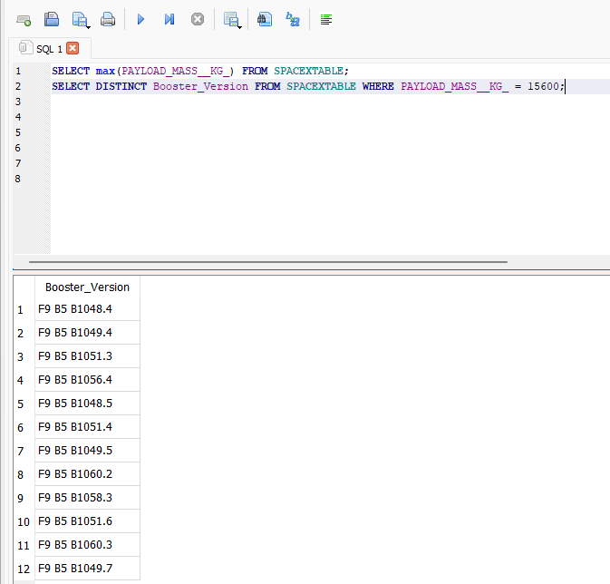
Boosters Carried Maximum Payload
List the names of the booster which have carried the maximum payload mass
The following 12 listed booster versions have carried the maximum payload mass of 15600 kg

Slide 32
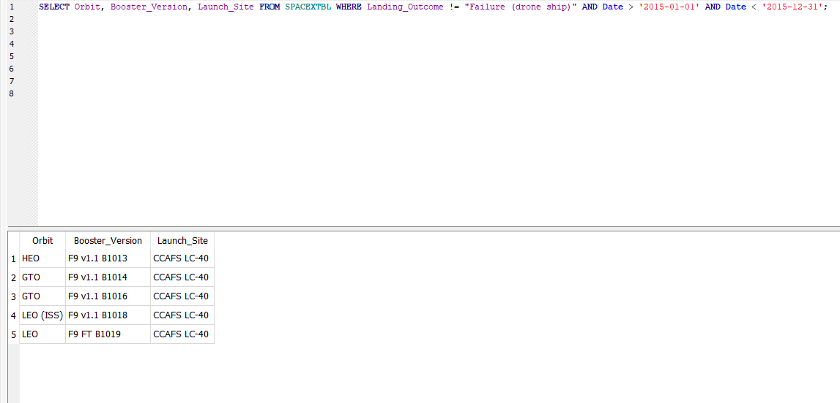
2015 Launch Records
List the failed landing_outcomes in drone ship, their booster versions, and launch site names for in year 2015
The following five launches had 2015 a failed landing outcome in drone ship

Slide 33
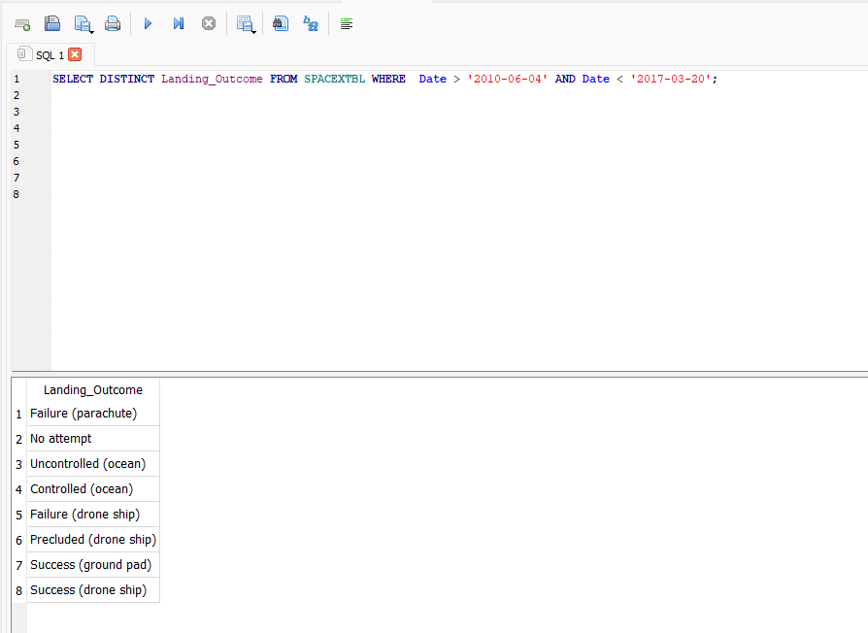
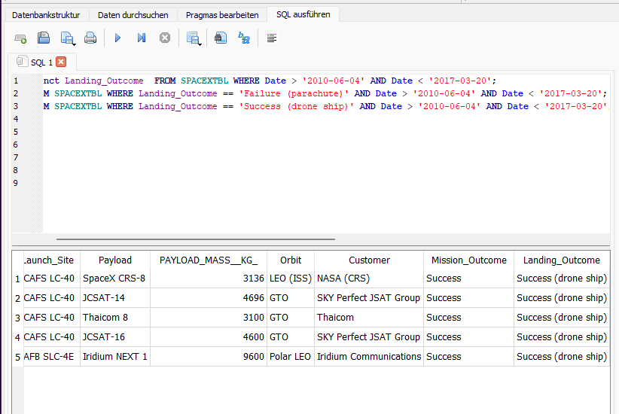
Rank Landing Outcomes Between 2010-06-04 and 2017-03-20
Rank the count of landing outcomes (such as Failure (drone ship) or Success (ground pad)) between the date 2010-06-04 and 2017-03-20, in descending order
Query result: there are 8 different types of landing outcomes like: “Failure (parachute)”, “Uncontrolled (ocean)” or “Success (ground pad”.
In the given period there were 1 launch ending in a “Failure (parachute)” and 5 successful launches with landing on a drone ship.

Slide 34

Section 3

Slide 35
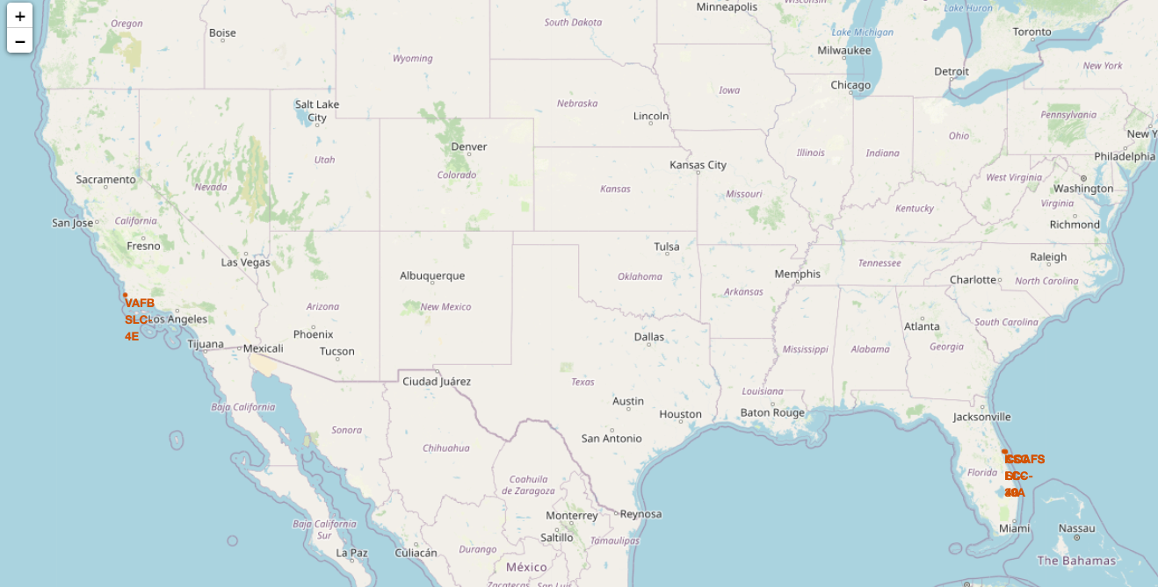
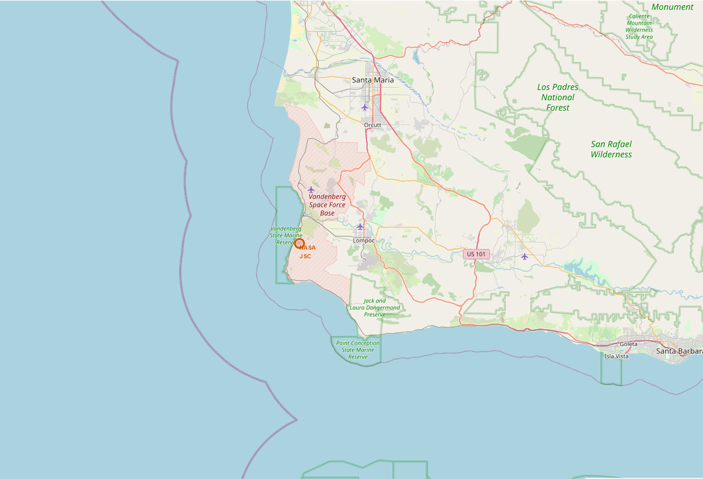
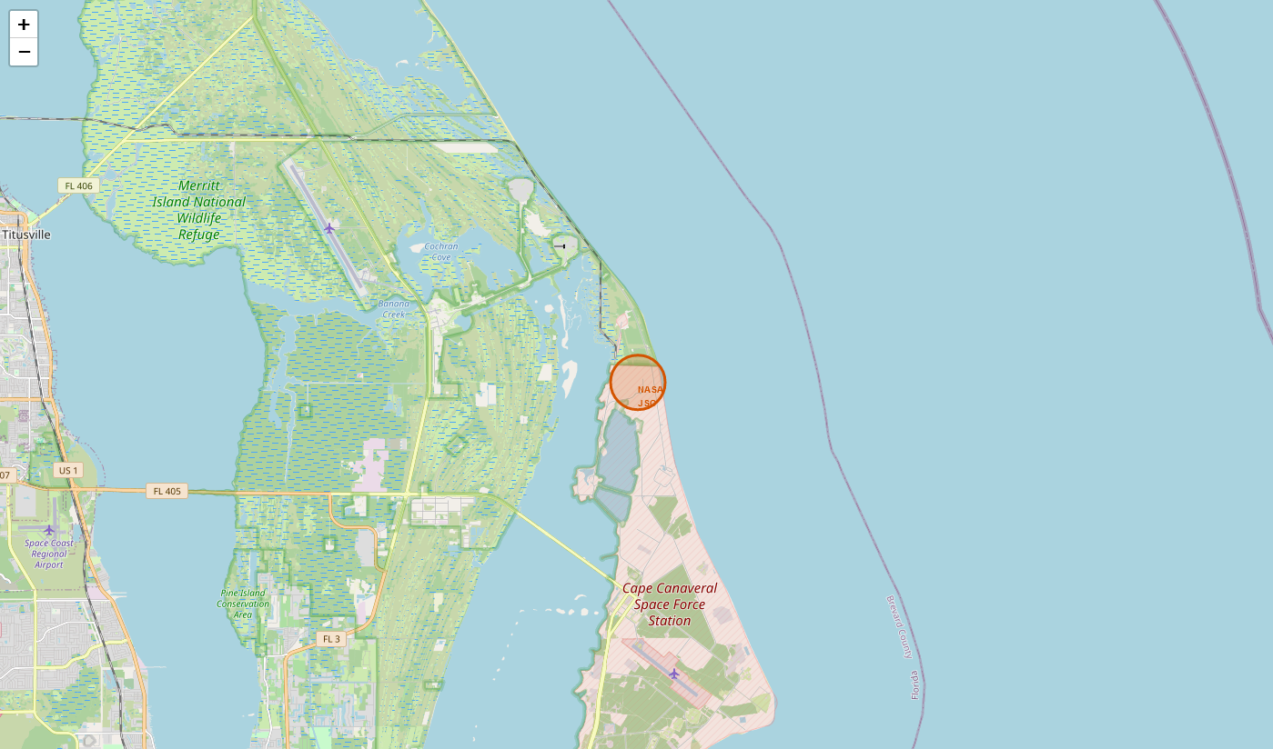
Global Position of Launching Sites (“CCAFS SLC 40”, “VAFB SLC-4E”)
→ All launch sites are placed in proximity to the Equator line and the sea coast.
Cape Canaveral Space Launch Complex SLC-40
Kennedy

Slide 36
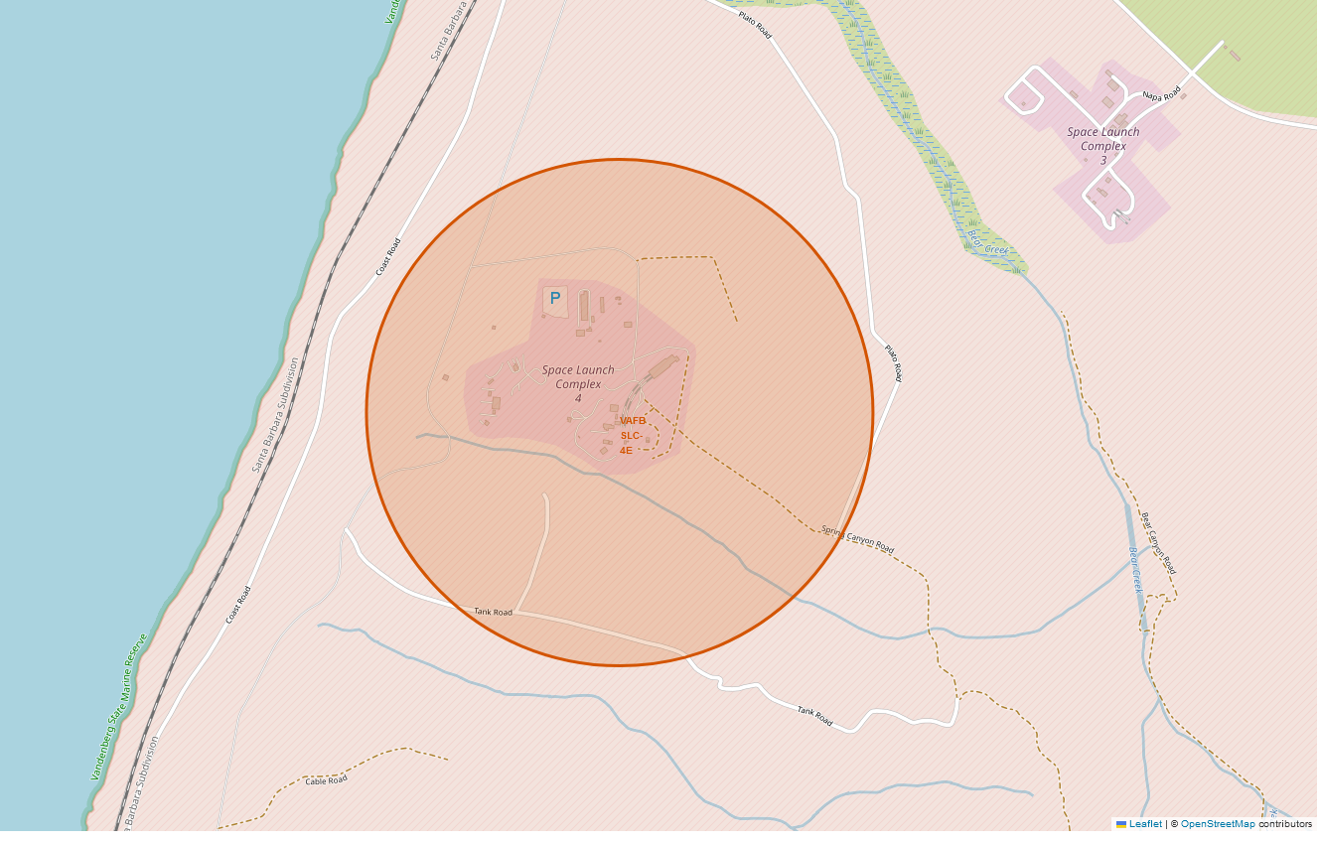
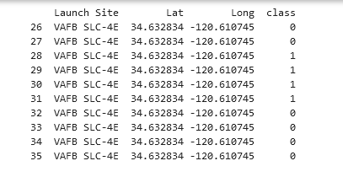
Vandenberg Air Force Base Space Launch Complex 4E : “VAFB SLC-4E”
Explain the important elements and findings on the screenshot
„VAFB SLC-4E launch site is located in proximity of an railway line and the sea coast.

Slide 37
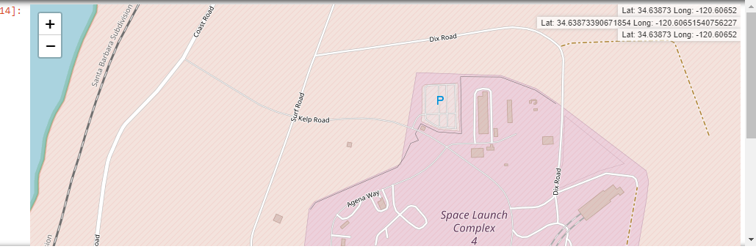
Vandenberg Air Force Base Space Launch Complex 4E : “VAFB SLC-4E”
The “VAFB SLC-4E” launch site is situated near railway and coastline.

Slide 38

Section 4

Slide 39
<Dashboard Screenshot 1>
Replace <Dashboard screenshot 1> title with an appropriate title
Show the screenshot of launch success count for all sites, in a piechart
Explain the important elements and findings on the screenshot

Slide 40
<Dashboard Screenshot 2>
Replace <Dashboard screenshot 2> title with an appropriate title
Show the screenshot of the piechart for the launch site with highest launch success ratio
Explain the important elements and findings on the screenshot

Slide 41
<Dashboard Screenshot 3>
Replace <Dashboard screenshot 3> title with an appropriate title
Show screenshots of Payload vs. Launch Outcome scatter plot for all sites, with different payload selected in the range slider
Explain the important elements and findings on the screenshot, such as which payload range or booster version have the largest success rate, etc.

Slide 42

Section 5

Slide 43
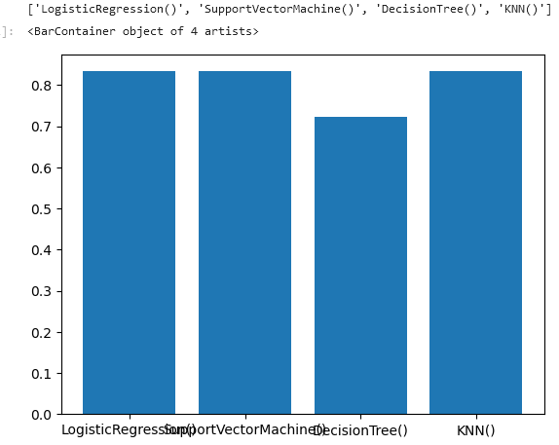
Classification Accuracy
The built model accuracy for all built classification models is shown in the following bar chart. Logistic Regression and KNN are my favorite models, having the highest classification accuracy ~0.833.
https://github.com/UdoRiegler/IBM_10_Capstone/blob/main/SpaceX_Machine_Learning_Prediction_Part_5.jupyterlite_solved.ipynb

Slide 44
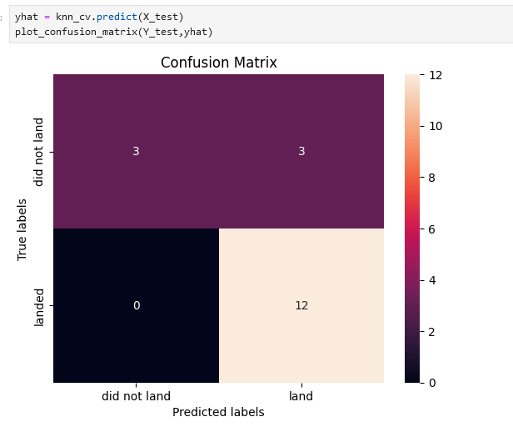
Confusion Matrix
The confusion matrix of the best
performing model is shown here.
Examining the confusion matrix, we see that logistic regression and KNN can distinguish between the different classes. We see that the major problem is false positives.

Slide 45
Conclusions
The success rate recovering the first stage of SpaceX is stable > 70% since 2019
This implies that every competitor like “SpaceY” must be able to over launchings at a competitive price level to SpaceX.
The significant cost saving due to reuse of the first stage will soon be state of the art
SpaceY should focus on the needed technology to offer similar features or to go beyond the level of SpaceX.
This facts should be know by the management of SpaceY before investing in testing capabilities, building and different samples of the launching system and all related parts.

Slide 46
Appendix
Include any relevant assets like Python code snippets, SQL queries, charts, Notebook outputs, or data sets that you may have created during this project

Slide 47


